Slide 1
Assessing Student Engagement via IDE Instrumentation
By Jerry Chen
Masters in Computer Science and Software Engineering
University of Washington, Bothell
2016
Committee Members:
Prof. Kelvin Sung, Chair
Prof. Rob Nash
Prof. Hazel Asuncion
Notes:
Good morning.
My project is called Assessing Student Engagement via IDE Instrumentation

Slide 2
Agenda
Introduction
Background
Methods
Results / Implications
Conclusion & Future Work
Notes:
The presentation today will have the following main sections
Introduction - talks about the problem/motivation of this project and the goals we hope to achieve by the end of the project

Slide 3
Agenda
Introduction
Background
Methods
Results / Implications
Conclusion & Future Work
Notes:
Background - investigation into previous researchers’ work to look for possible solutions

Slide 4
Agenda
Introduction
Background
Methods
Results / Implications
Conclusion & Future Work
Notes:
Methods - design decision along the way and how our solution is implemented

Slide 5
Agenda
Introduction
Background
Methods
Results / Implications
Conclusion & Future Work
Notes:
Results/Implications - I will show you the data and analysis collected

Slide 6
Agenda
Introduction
Background
Methods
Results / Implications
Conclusion & Future Work
Notes:
Conclusion & Future Work - Lastly I will summarize the overall findings of this project and lay down tasks to continue this project in the future

Slide 7
Introduction
GTCS
Instrumentation
Goal

Slide 8
Game Themed Computer Science Curriculum
Designed to increase engagement
Demonstrated to be effective [14, 15]
But lack detailed information
Notes:
Designed to increase engagement in introductory programming course
GTCS is a different way of teaching when compared to traditional CS course. traditional assignments can be less attractive or entertaining, such as text-based blackjack or pizza calculator, just to name a few
Assignments are games
GTCS uses interactive game to keep students interested and entertained
Demonstrated to be effective in getting better learning outcomes [14, 15]
Students do better in assignments when compared to traditional assignments because they spent time playing.
But detailed information
However, we do not have detail in how student work with GTCS when they program

Slide 9
Instrumentation
Build into IDE to track activities
Such plugin should be of several features
Light weight
Have zero performance impact on IDE [11]
Notes:
Build into IDE to track activities
An instrumentation is the collection of data from monitoring some system.
Our instrumentation aims to track students behaviors and activities while they work on assignments
We’ve applied and received permission from the IRB (institutional review board) to conduct the tracking as long as we can maintain students’ anonymity
Some activities that we would like to track include,
Time spent in a programming session
Parts of assignment that took most time
The most common compiler errors
Such plugin should be of several features
Our instrumentation will be build in the form of a plugin, and it should be
The plugin shouldn’t require too much memory when installed and running
The plugin should run seamlessly in the background without having any effect on the IDE or the users

Slide 10
Goals
Design and implement instrumentation to existing IDE
Collect data from CSS161
Establish infrastructure and foundations for future GTCS research
Notes:
Design and implement instrumentation do existing IDE
Our goals include understanding how to add instrumentation in an IDE
Collect data from CSS161
Another goal is to collect data from CSS161 with a working prototype while they program
Produce infrastructure and foundations for future GTCS research
And using the findings of this project to create a proof-of-concept infrastructure to answer questions regarding GTCS and lay down foundation for future researchers

Slide 11
Background
Previous Research
Initial Attempt
BlueJ and Blackbox

Slide 12
Previous Research
Low retention rate [6]
ClockIt [9]
Retina [8]
Research Questions defined by end user
Notes:
In previous research,
Low retention rate [6]
They were aiming to solve the decrease in retention rate by finding out where students struggle most, so that instructor can help them to learn better

Slide 13
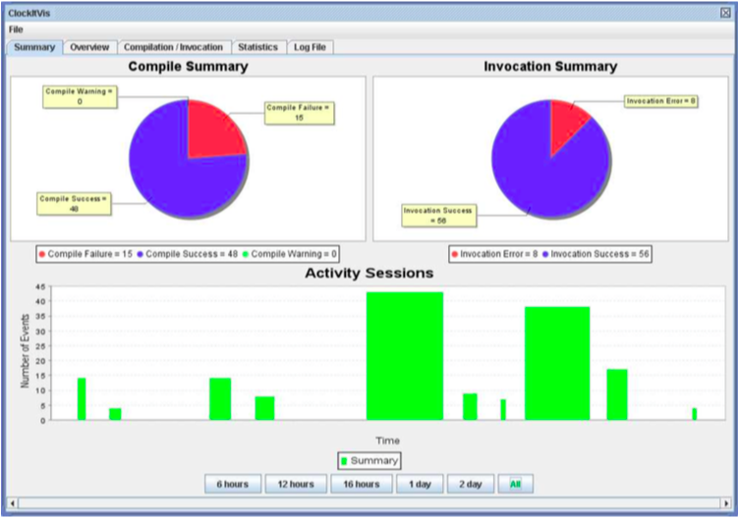
Previous Research
Low retention rate [6]
ClockIt [9]
Retina [8]
Research Questions defined by end user
Notes:
In another research,
ClockIt [9]
Clockit, is a BlueJ Extension that which has a data logger and data visualizer
They were tracking traditional CS course to provide details for students to compare their performance with fellow classmates

Slide 14
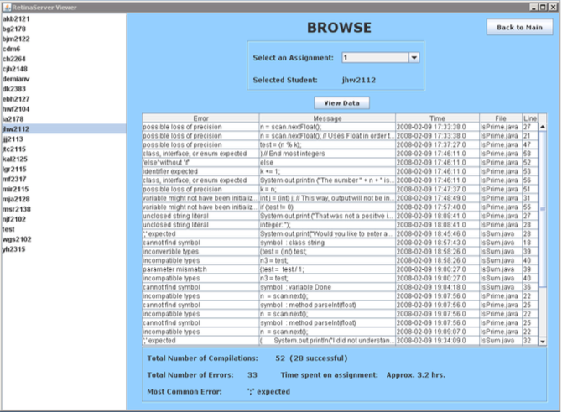
Previous Research
Low retention rate [6]
ClockIt [9]
Retina [8]
Research Questions defined by end user
Notes:
Retina [8]
The retina project also have support for BlueJ, and Eclipse to provide an in-depth detail per students for the instructors

Slide 15
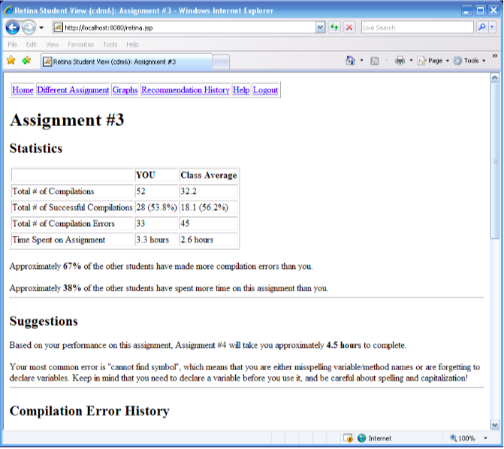
Previous Research
Low retention rate [6]
ClockIt [9]
Retina [8]
Research Questions defined by end user
Notes:
Retina [8]
The retina project also have support for BlueJ, and Eclipse to provide an in-depth detail per students for the instructors
Also aims to provide feedback by allowing students to compare their performance with fellow classmates

Slide 16
Previous Research
Low retention rate [6]
ClockIt [9]
Retina [8]
Research Questions defined by end user
Notes:
Most previous research worked on improving students learning by using tracking IDE on how students work
We are similar to previous research but we want to understand how GTCS work, and our research questions are formulated by our end user, Prof. Rob Nash, as he teaches CSS161 and have interesting questions regarding GTCS

Slide 17
Initial Attempt
Custom plugin taylor to our specifications
Eclipse Rabbit
Eclipse plugin architecture
Blackbox by BlueJ
Notes:
Custom plugin taylor to our specifications
In the beginning, we wanted a custom plugin to track mouse clicks, key pressed, and duration of sessions
By doing so, it will possible we can do more advanced tracking

Slide 18
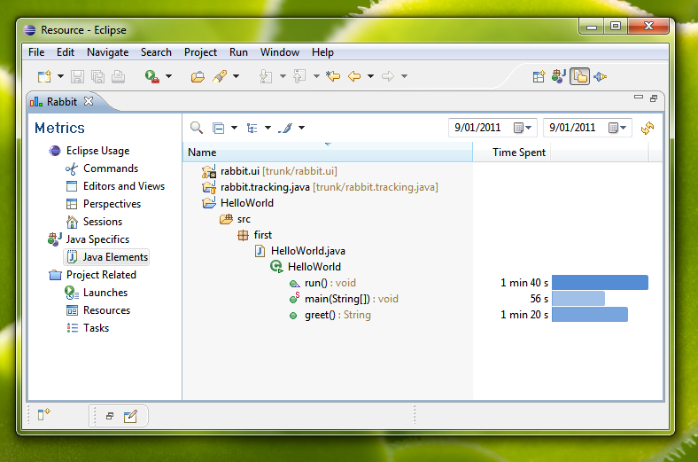
Initial Attempt
Custom plugin taylor to our specifications
Eclipse Rabbit
Eclipse plugin architecture
Blackbox by BlueJ
Notes:
Eclipse Rabbit
Thats when we found Rabbit on the Eclipse Marketplace
We searched for extensions in Eclipse because we thought Eclipse was an ideal IDE to start with for its popularity among programmers

Slide 19
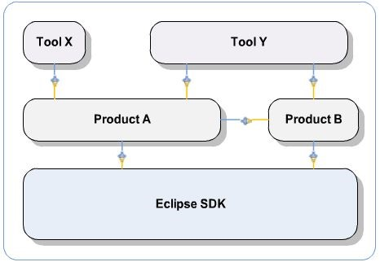
Initial Attempt
Custom plugin taylor to our specifications
Eclipse Rabbit
Eclipse plugin architecture
Blackbox by BlueJ
Notes:
Eclipse plugin architecture
However, the Eclipse architecture, open platform, is so sophisticated that would require a thorough understanding in different components to just enable basic tracking.
JDT (Java Development Tool)
PDE (Plugin Development Environment)
Each comes with different sets of plugin for its development purpose
All eclipse comes with SDK at the core, the most generic package
A product in an editor, which can be
Extended into a tool such as XML editor
Our first prototype used Rabbit both as foundation and inspiration, and took almost two month to develop to track one feature.
Therefore, for the goals of the project we decided to look for alternatives for tracking our students

Slide 20

Initial Attempt
Custom plugin taylor to our specifications
Eclipse Rabbit
Eclipse plugin architecture
Blackbox by BlueJ
Notes:
Blackbox by BlueJ
This is when we found a solution provided by BlueJ and will not require us to create the instrumentation from scratch
Which allows us to devote more time into data analysis and designing infrastructure to use their data archive

Slide 21
BlueJ and Blackbox
BlueJ
Free
Popular for teaching introductory programming
Blackbox
A automatic and continuous data collection project
Initiated by a founder of BlueJ
Remote data storage in UK
Notes:
BlueJ
Free
A brief intro of BlueJ. it is a free IDE that is available across multiple platforms and is still being maintained, the latest released was on Feb 2016.
Unlike Clockit or Retina, which are proprietary and unavailable to the public
Popular for teaching introductory programming
BlueJ was designed in the first place as a minimalistic IDE to provide only the most needed components to learn programming

Slide 22
BlueJ and Blackbox
BlueJ
Free
Popular for teaching introductory programming
Blackbox
A automatic and continuous data collection project
Initiated by a founder of BlueJ
Remote data storage in UK
Notes:
Blackbox
Blackbox is an automated and continuous data collection project initiated by one of the founders of BlueJ. The data archive is available to researchers across the globe.

Slide 23
Blackbox limitations
Can not differentiate individual students
Multiple users sharing one computer
Multiple computers used by one user
Notes:
Can not differentiate individual students
A limitation in Blackbox is that we can not differentiate individual students, because Blackbox assigns a unique user_id per machines that enables data collection, not per user on the same machine
Multiple users sharing one computer
We can not differentiate different users’ activities with only one id per computer
Multiple computers used by one user
Conversely, we cannot differentiate activities of the same user when they work on multiple computers

Slide 24
Methods
Design
Implementation
Notes:
In the method section, I will discuss the design for the infrastructure and how we implemented the modules for transferring data back from Blackbox and for post analysis.

Slide 25
Design (Infrastructure)
Local Data storage
Data transfer
Checkpoint system
Data analysis
Notes:
Project infrastructure
The project consists of three components
Setting up a local server
Data transfer
Data analysis

Slide 26
Design
Local Data storage
Data transfer
Checkpoint system
Data analysis
Notes:
Data storage
Local DB
We need a local data storage for our data and not the millions of other data
Because Blackbox archive is shared, we dont want to take up too much resource with data manipulation on the remote server, just to be considerate for other researchers

Slide 27
Design
Local Data storage
Data transfer
Checkpoint system
Data analysis
Notes:
Data transfer
When transferring data, we only want data from our students
Therefore we need to filter data using identifiers we provided to students
Checkpoint system
Because there are many tables to download, we introduce the checkpoint system
So that data transfer can recover from interrupted process should the internet fails

Slide 28
Design
Local Data storage
Data transfer
Checkpoint system
Data analysis
Notes:
Data analysis
We created a suite of utility modules to perform data manipulation, which include
Retrieval data from the local database
Generate graphs using the retrieved data
A GUI to see the output
As well as individual modules for every question as requested

Slide 29
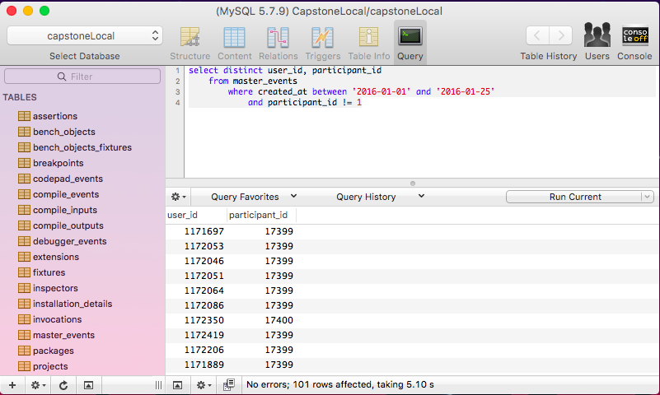
Implementation (Local Data Storage)
MySQL
16 tables
SequelPro
Notes:
Mysql
We chose MySQL in order to keep database data consistent with Blackbox
16 tables
We found that there are 16 relevant tables out of 33 tables
SequelPro
I chose SequelPro as the database management software to test query, make local backups, and it is easier to view the tables
Compared to MySQL Workbench, it has a simpler UI

Slide 30
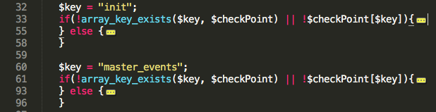
Implementation (Data Transfer)
Checkpoint system
The Master Events Table
Events triggered by our students
Detail of tables
Notes:
Checkpoint system
We introduced the checkpoint system because the download time for all relevant tables can take up to days depending on internet condition
Therefore we want to decrease the total download time by avoiding downloading completed tables
We use a per-table checkpoint that updates the download status after each successful download
The snippet shows how the checkpoint system work. Each table has a key and will be updated once the transfer has completed

Slide 31

Implementation (Data Transfer)
Checkpoint system
The Master Events Table
Events triggered by our students
Detail of tables
Notes:
The Master Events Table
The master events table is the most important table that ties to all detailed tables
We can filter out our students from the master event table with identifiers provided to the students
Experiment identifier = uwbgtcs
Participant identifier = css161nash
This is the most important query that will return all of our students
We chose to return the three fields because some of them will be used to retrieve other tables

Slide 32
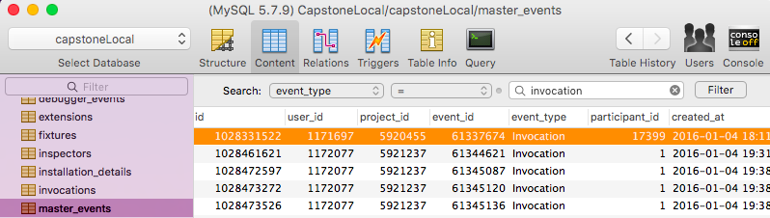

Implementation (Data Transfer)
Checkpoint system
The Master Events Table
Events triggered by our students
Detail of tables
Notes:
Events triggered by our students (refer to query)
After filtering out our students, we need to identify all types of events triggered by them using this query(point)
Because that tells us which tables to we need to download for obtain details
For example, a event type of Invocations in the master event, represents more details recorded in the invocations table

Slide 33
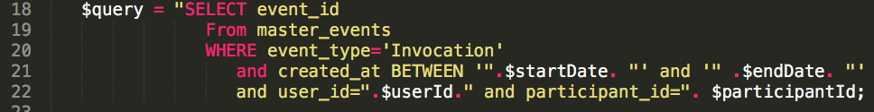
Implementation (Data Transfer)
Checkpoint system
The Master Events Table
Events triggered by our students
Detail of tables
Notes:
Detail of tables (of the most significant ones)
I’m going to talk about a few of the more significant tables that we have used later
To provide some idea as to what details they contain
For example, sessions table contains user id and date of session
During a compilation, information is spread into three tables (compile input, compile output, compile event)
The compile inputs table contains the source file name and compile event id that ties back to master event, and compile output contains whether the compilation was successful
The invocations table contains function name when its called, whether success or failed, and the session it was called
However, there are tables we dont need (total number of tables)
For example, we do not need the test table since using test classes is not a part of CSS161, therefore students did not trigger any record
Another example is the version control table. Because assignments are too small, students do not need repository for their assignment
Explain query pictures (Generic query for all tables, query to retrieve all invocations )

Slide 34
Implementation (Data Analysis)
Structure of utility
A module per question
Notes:
Structure of utility
The diagram shows two major scripts that are shared.
coreFunction script contains shared functions relating to DB queries, connection to DB, checkDate
graphFunction script contains visualization functions, and supports displaying on the guiPage

Slide 35
Implementation (Data Analysis)
Package diagram
A script per question
Notes:
A module per question
Posted questions are broken down into individual module for efficiency and other manipulations

Slide 36
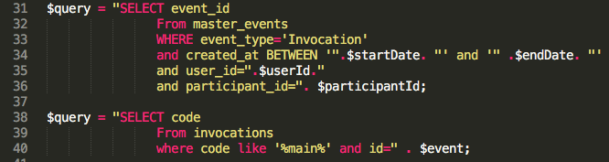
Implementation (Data Analysis)
Package diagram
A script per question
How many times have students run the game?
Notes:
The snippet demonstrate how we created iterations of simple queries for a question
There are 7 questions we aim to question
The question here is how many times have students run the game?
We begin by finding out tables that have detailed information we need
Find the unique key from master event data point to retrieve the corresponding detailed table
And loop
Iterations of similar queries were performed to answer the 7 questions
Start with query to access individual table and then combine data to compute result
This way it’s more efficient than complex query with “join” statement, because it ensures readability and maintainability for future researchers

Slide 37
Results / Implications
Top Ten Compiler Errors
Participation rate per instructor
Number of sessions per user
Timing of sessions throughout the assignment
Number of times the game was executed
Last few events before user closed BlueJ
Time spent in the SpaceSmasherAPI package
Notes:
Investigated the tools for visualization and approximation to the question
These are our first pass result.
Questions were provided by Rob that he is interested in the GTCS

Slide 38
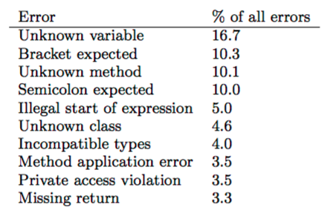
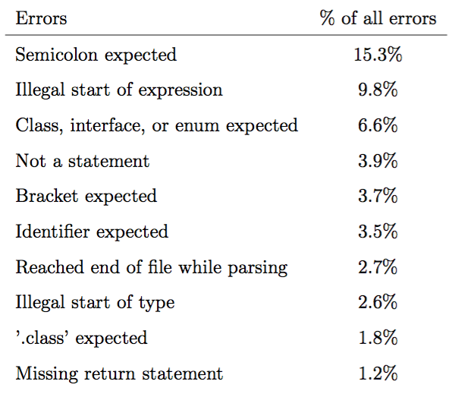
Top Ten Compiler Errors
Previous Ten Errors
Our Ten Errors
Notes:
The top ten errors was done by previous researcher.
Who also used BlueJ as data.
We would like to verify that the tracking is working and we can produce some approximation using the tracking data.
As you can see here, we have similar types of errors when compared to previous researchers.

Slide 39
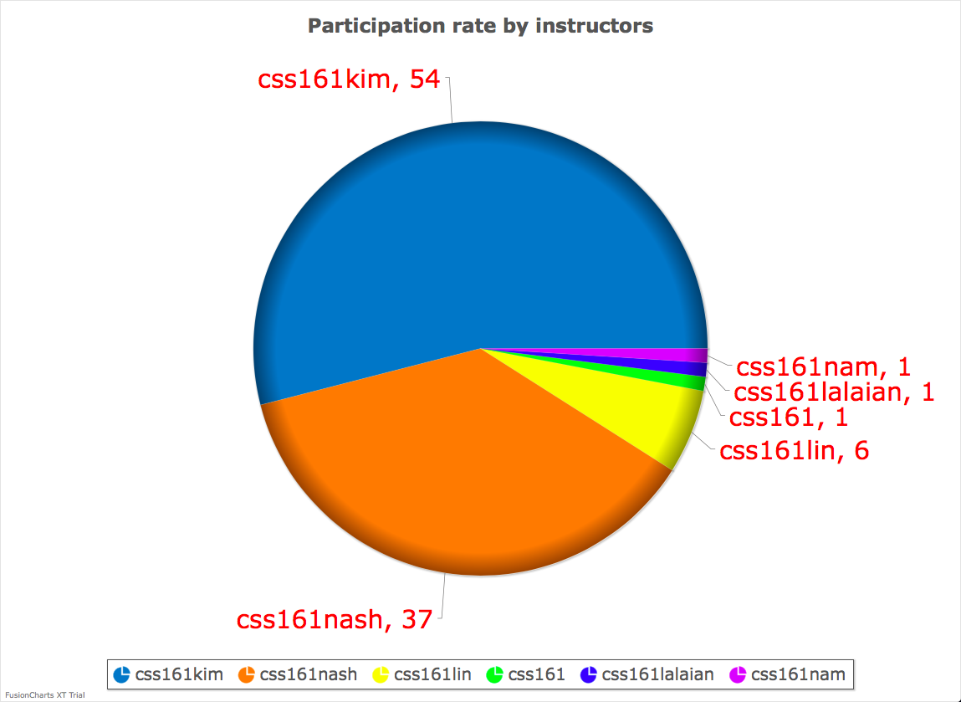
Participation Rate Per Instructor
Notes:
Just like the first question, we would like to know the participation rate from each class just to understand what is happening.
This data was collected last quarter.
Our coordination with instructor didnt work out as expected
Which explains why there are instructors with very low number.
Either the majority of the class do not want to participate, or it could be the result of students having preference to work on their machine instead of school’s lab machines

Slide 40
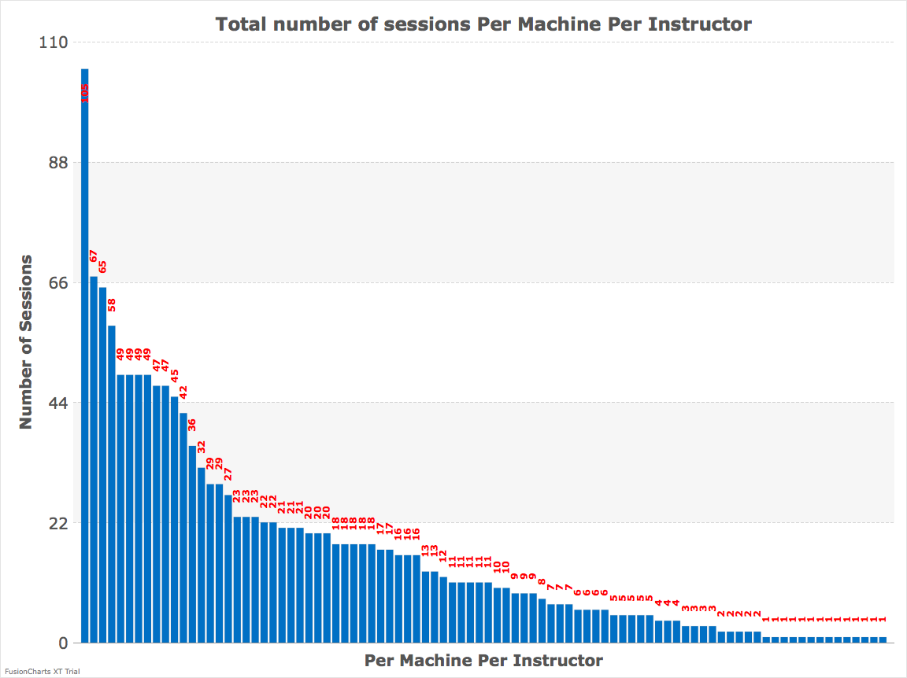
Number of Sessions Per Machine Per Instructor
Notes:
We would like to know how many times GTCS students opened the assignment.
Our result showed that the average number of sessions a day is 16.
But that is a little strange, since a session in BlueJ is opening BlueJ itself.
This means BlueJ was opened 16 times a day.
Perhaps students got distracted by other things

Slide 41
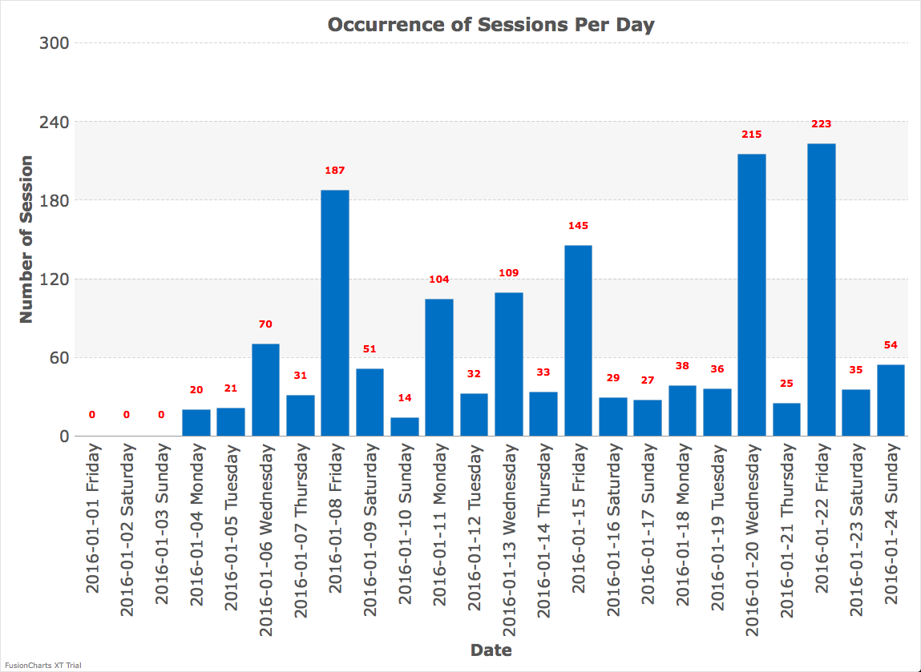
Timing of Sessions Throughout The Assignment
Notes:
The next question comes down to which day do students mostly do their work?
We hope that, with GTCS, students will work more often.
Our result showed that Fridays during lab sessions and when the assignments was due has the highest number of sessions.
And follow by Saturday because student might be working due to late submission.

Slide 42
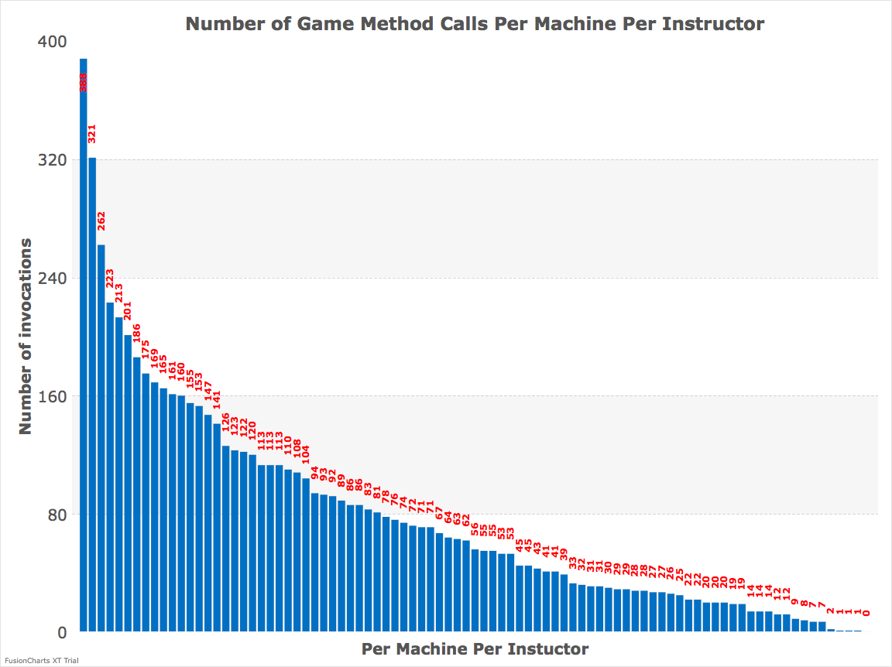
Number of Times The Game Was Executed
Notes:
We want to know how many times have they ran the game.
The higher the number of function call might indicate higher level of interest.
We looked for all function calls that contains “main” and heres our result.
On average, throughout the first assignment which was about a month long, the average number of function call was 77 times.
That turns out to be about running the game 2 times a day.
It is surprisingly low for an interactive game, not to mention if it was a non interactive game.
But in reality, the number should have been higher because students would need to run the game to debug them.
Unless they succeed all requirements in one run.

Slide 43
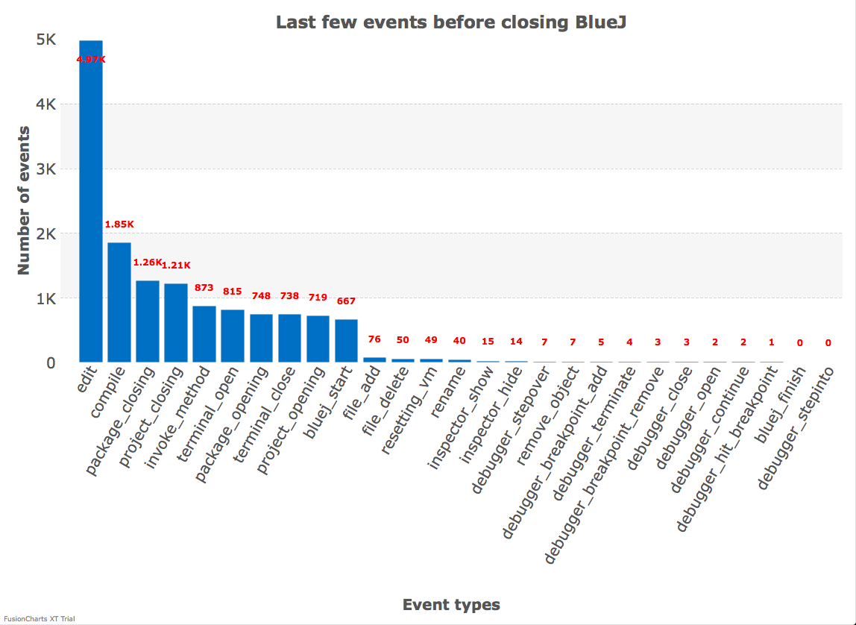
Last Few Events Before BlueJ Closed
Notes:
What do students do before they closed Bluej?
The result shows the last 20 events that students did before they closed BlueJ.
The highest recorded last thing student do was edit.
However, that isn’t so surprising consider that most of programming session would have been editing.
What would’ve been interesting is to see a higher number of invoke_method, because that could be students attempting to run the game

Slide 44
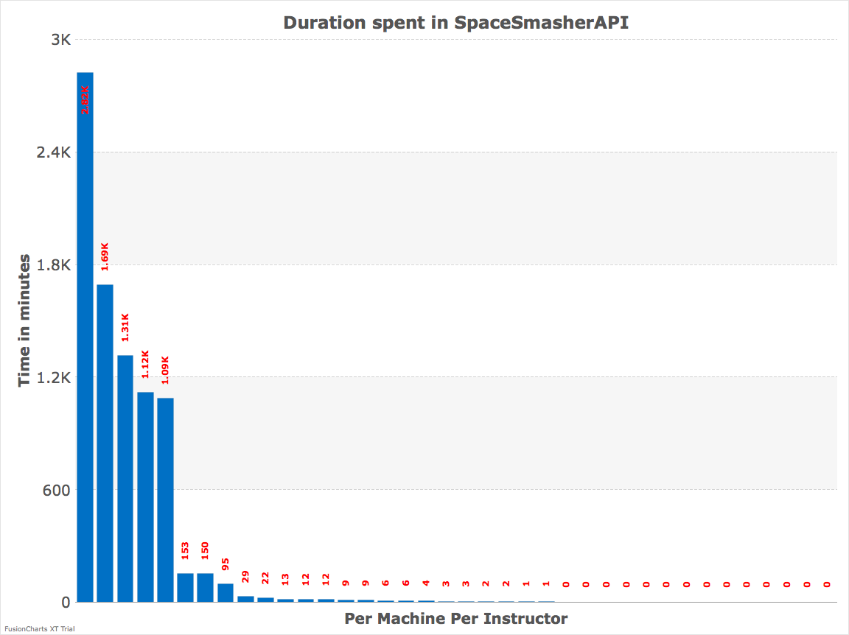
Time Spent in SpaceSmasherAPI
Notes:
The last question we asked was, do students modify the API at all?
Though we can not tell what they do in the package, we can tell how long they spend in the package
We found that only a few students spend long enough time to probably do something.
The most interesting observation here is that one students actually have spend over 2800 minutes, or about 50 hours, in the API
Throughout the first assignment.

Slide 45
Conclusion & Future Work

Slide 46
Conclusion
Customize tracking tool is challenging
Adopted Blackbox
Developed infrastructure and demonstrate feasibility
Notes:
In conclusion, we have
Started by understanding how to track in an IDE
Learn a little bit about what to track
Developing tracking system from scratch may not be the best idea
Adopted Blackbox
Which is when we have adopted an existing system instead of creating a plugin from ground up because Blackbox was more efficient and has all functionalities we need
Developed infrastructure and demonstrated feasibility
We established local database to archive our data
And created modules to transfer data from Blackbox and retrieve data from the local database for analysis
As well as using the data to provide an approximation to the posted question

Slide 47
Future Work
Improve data transfer
Collect more data
Create more questions with triggered events
Notes:
All in all, the project is a good sign that the research has future potential in regards to GTCS, here are some future tasks
Improve data transfer
Finer grain recovery
We can improve data transfer by
One way is to parallelize module to handle tasks in threads
Second way is to create SQL queries to return smaller chunks of result at a given time
Collect more data
We definitely need more data to strengthen the implication of GTCS
And data from a non GTCS class
Create more questions with triggered events
We could also investigate into other data that Blackbox tracks that might help us understand other implications of GTCS

Slide 48
Demo

